Slide 1
SUPPLY CHAIN MANAGEMENT

Slide 2
AGENDA
Group Details
Summary Of The Project
KPI list
Excel Dashboard
PowerBi Dashboard
Tableau Dashboard
SQL
Suggestions
Key take away

Slide 3
GROUP MEMBER DETAILS
1.Sandhya Cherukuri
2. Harsha Gudumotu
3.Imran Ali
4.Mona Grace R

Slide 4
KPI List
1.Total Sales(MTD,QTD,YTD) | 7.Region Wise Sales
2.Product Wise Sales | 8.Total Inventory
3.Sales Growth | 9.Inventory Value
4.DailySalesTrend | 10.OverStock, Out-of-Stock, Under-Stock
5.State Wise Sales | 11.Purchase Method Wise Sales
6.Top 5 Store Wise Sales

Slide 5
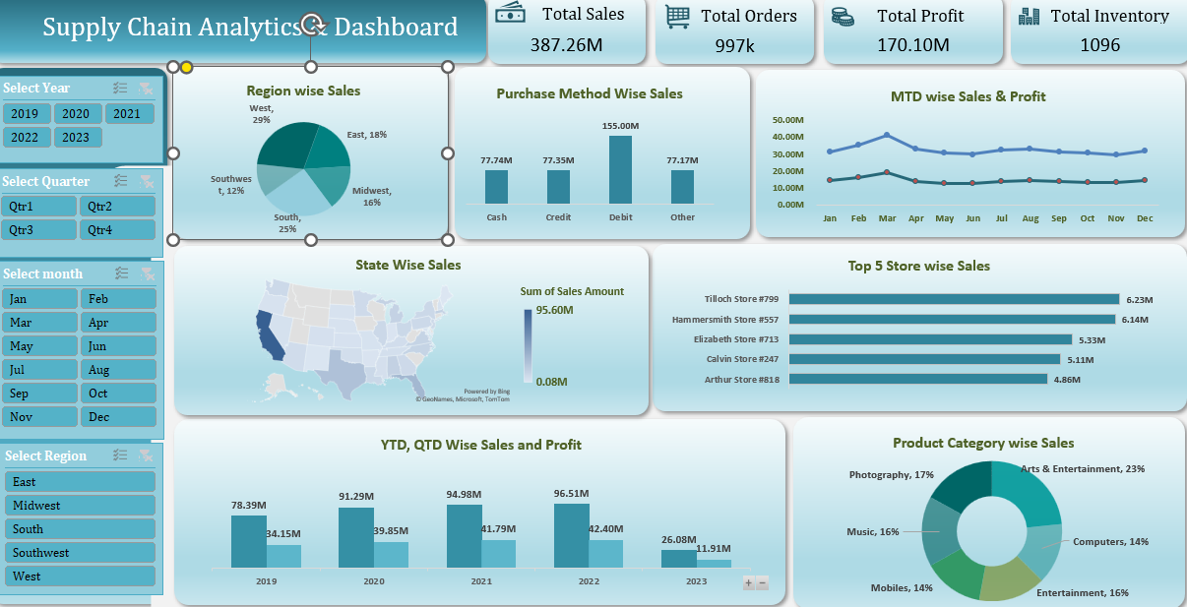
Excel DaSHBOARD

Slide 6
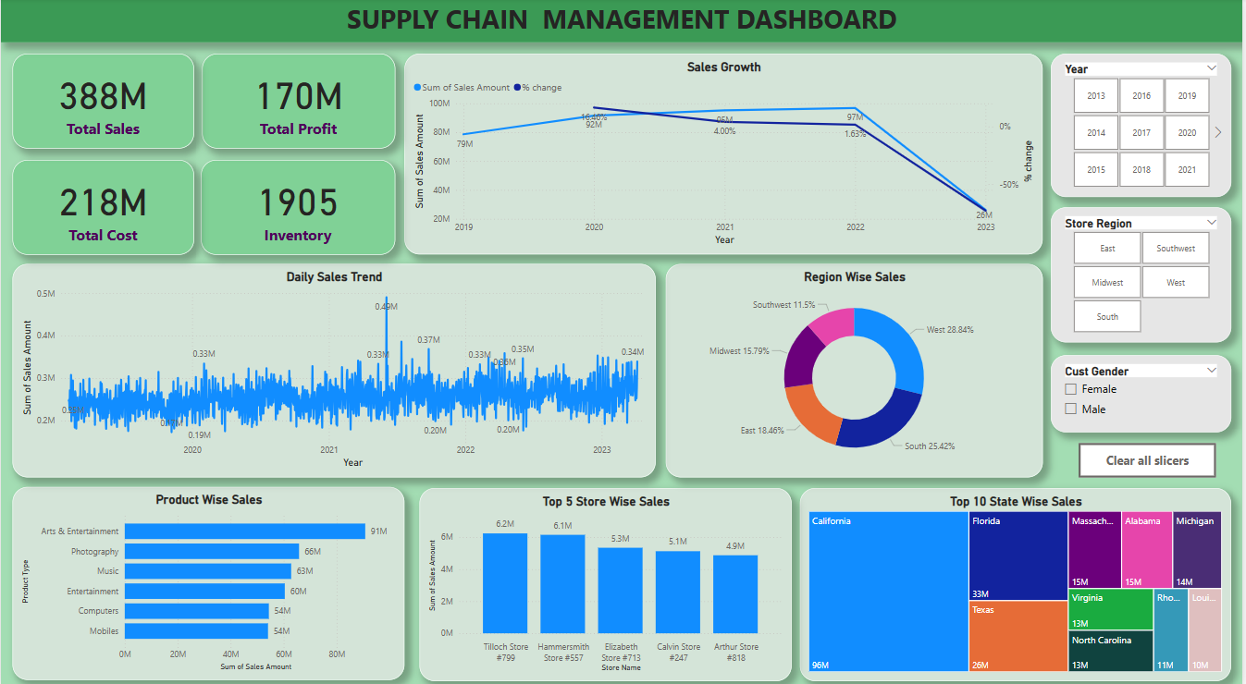
POWERBI DASHBOARD

Slide 7
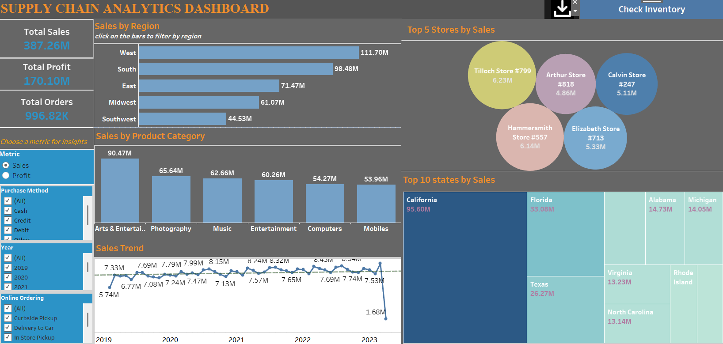
TABLEAU DASHBOARD

Slide 8
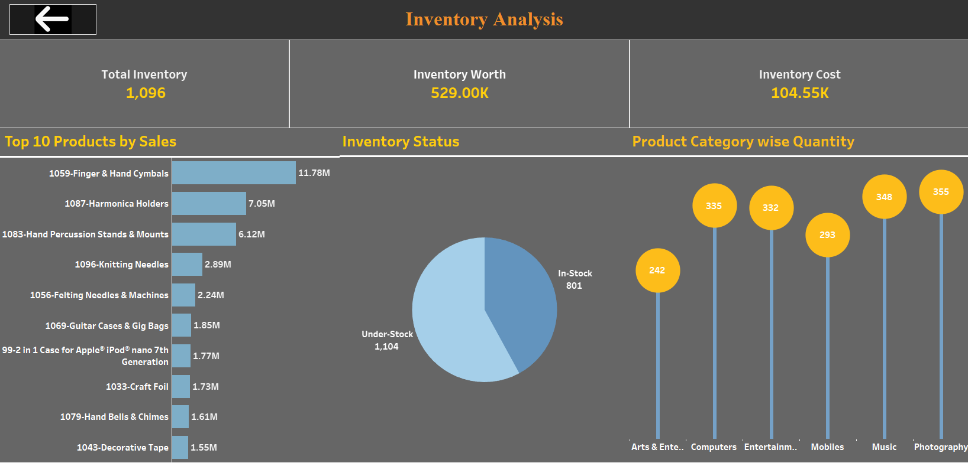
Inventory Dashboard

Slide 9
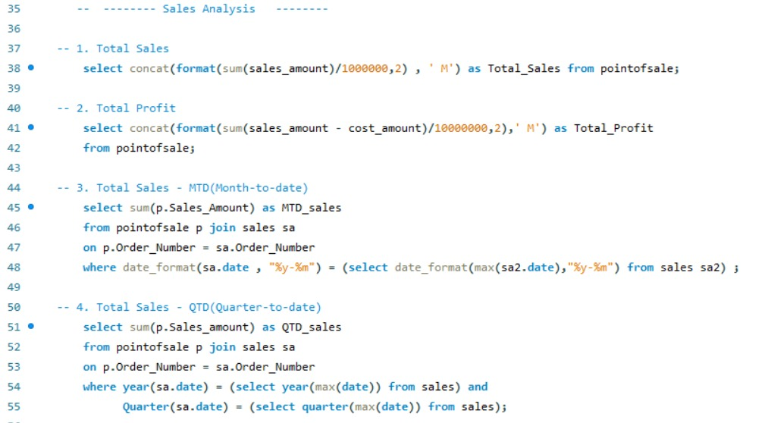
SQL QUERIES

Slide 10
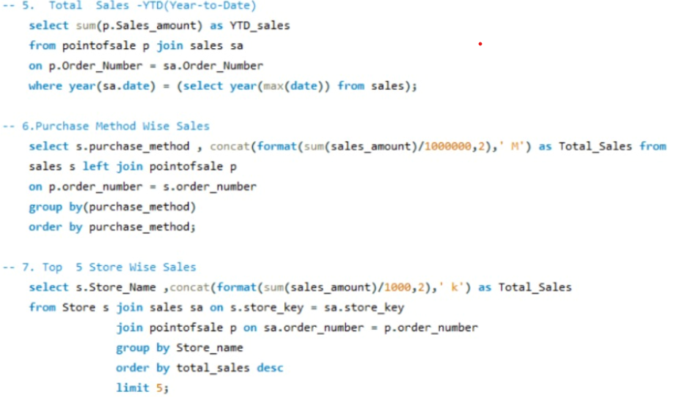
SQL QUERIES

Slide 11
SUGGESTIONS
KPI1-Total Sales(MTD,QTD,YTD):
Total sales figures, particularly Month-to-Date (MTD), Quarter-to-Date (QTD), and Year-to-Date (YTD), play a crucial role in supply chain management by providing insights into current demand trends, helping predict future requirements
KPI2-Product Wise Sales:
In supply chain management, a product-wise sales role involves understanding and aligning sales activities with specific product lines to optimize demand, inventory, and overall supply chain performance
KPI3-Sales Growth:
By using Sales growth can track business expansion ,profit and losses and seen has key driver of overall business

Slide 12
SUGGESTIONS
KPI4-Daily Sales Trend:
By leveraging daily sales data, companies can make more informed decisions about production, procurement, and distribution, ultimately leading to increased efficiency and profitability.
KPI5-State Wise Sales:
Evaluate state wise sales to identifying regional demand patterns. By analyzing sales performance at the state level, businesses can make more informed decisions about where to allocate resources, tailor marketing efforts, and reduce costs
KPI6-Top 5 Store Wise Sales :
By focusing on the most successful stores, businesses can gain valuable insights into which products are popular, which stores have higher demand, and how to best allocate resources. This data helps refine inventory management strategies, reduce costs, and ensure timely delivery of products to meet customer needs.

Slide 13
SUGGESTIONS
KPI7-Region Wise Sales:
By monitoring this, helps companies understand where their products are most in demand, allowing for better resource allocation and reduced costs.
KPI8-Total Inventory:
Total Inventory helps businesses to ensure they have enough stock to meet customer demand, optimize operations, reduce costs
KPI9-Inventory Value :
Analyzing Inventory value helps businesses to make informed decisions about sourcing, production, and distribution, ultimately impacting profitability and customer satisfaction.

Slide 14
SUGGESTIONS
KPI10-Overstock,Out-of-stock,Understock:
In supply chain management, overstock, out-of-stock (stockout), and understock all represent different inventory challenges, each impacting the efficiency and profitability of a business.
These terms are crucial for effective inventory management and understanding their implications can help businesses optimize their supply chains.
KPI11-Purchase Method Wise Sales:
Analyzing sales based on different purchase methods can help businesses by optimizing inventory, f, and improving supplier relationships. This information allows for better resource allocation, reduced costs, and improved overall supply chain efficiency.

Slide 15
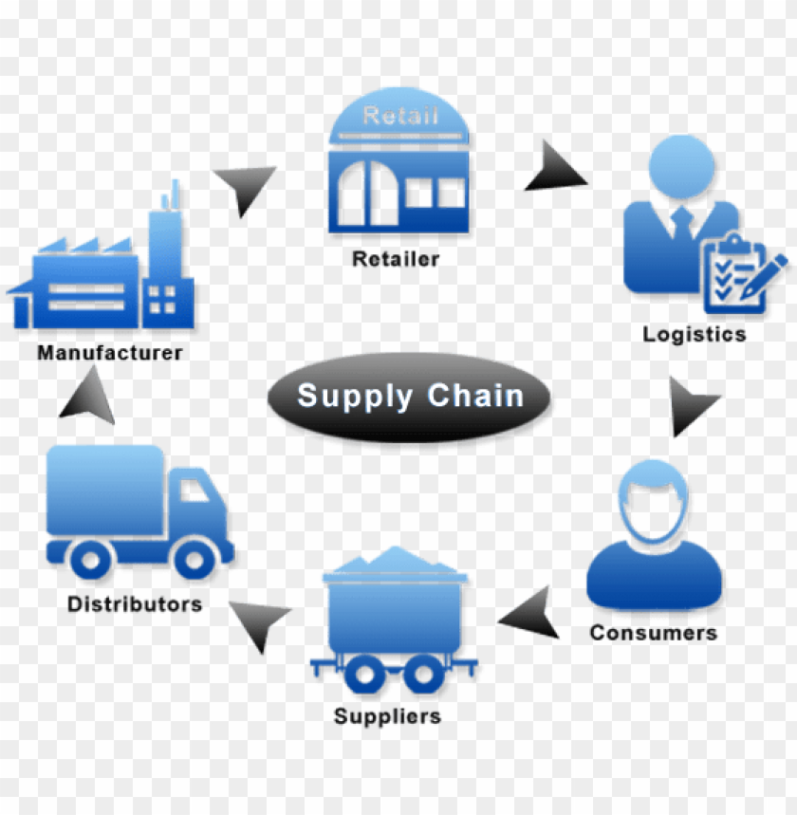
Summary Of the Project
The analysis shows total sales of 388M across 37 states with1096 products and an inventory of 1905 items valued at 222K.
Arts and Entertainment products have the highest sales , while mobiles have the lowest.
The West region leads in sales , with California as the top state.
Woodland store has the highest sales and York has the lowest.
To boost overall sales , focus should be on selling overstocked products and ensuring understocked products are available in stores.
This strategy is expected to improve yearly and store-wise sales growth

Slide 16
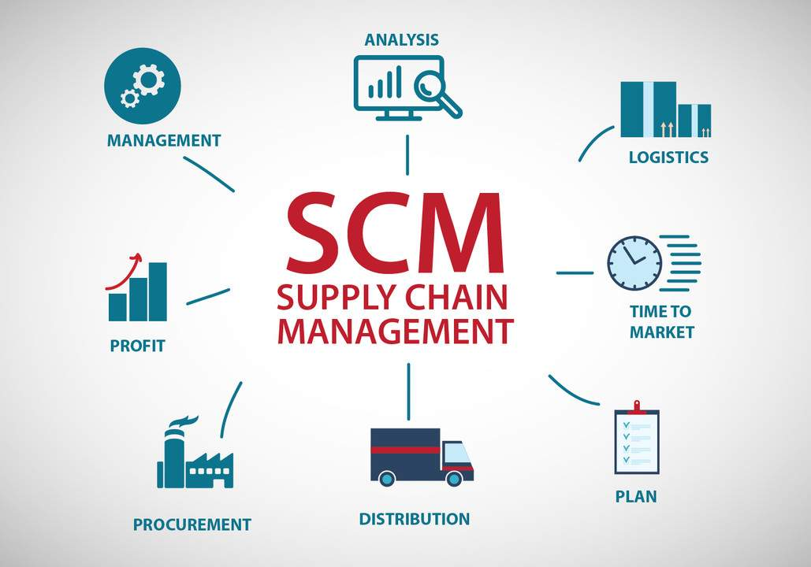
KEY TAKEAWAY
The Key Takeaway from this, Supply chain management project is the critical importance of optimizing the flow of goods, information, and finances across the entire supply chain, from raw materials to the end consumer.
And also, Helps us to make strategic approach in managing the interconnected network of activities that is essential for achieving organizational goals and maintaining a competitive edge in today's dynamic global marketplace.

Slide 17
Thank You!!!

